Slide 1
ASA Data Fest Drug Exposure among Aboriginal people. Team: LOG_I_RITHMS
Team members:
[Mukto Akash, Vansh Joshi, Logan Watchorn, Nitish Joshi]

Slide 2

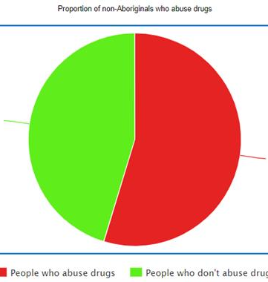
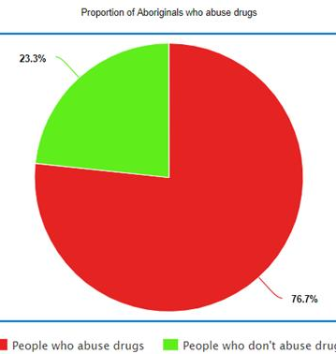

Slide 3
